Slide 1

Human Resource Management IMOE01
Sudheer D. Kulkarni

Slide 2
Human resources slide 4
Training and Development
Recruitment and Selection
Induction and Communication
Introduction to Human Resource Management:
Man Power Planning
Performance Appraisal
HUMAN RESOURCES

Slide 3
Course Content
Unit –I
Introduction to HRM: Evolution of HRM, Objectives, Functions and Policies.
Man Power Planning: Uses and benefits, Man Power Inventory, Man Power Forecasting, Methods of Man Power Forecasting.
Unit –II
Recruitment and Selection: Sources of man power, advertisement, short listing of candidates for Selection procedure – Written Test, Group Discussion, Interview – Different methods, advantages and Limitations, Psychological testing – Advantages and limitations.

Slide 4
Unit –III
Training And Development : Identification of Training needs, Training Evaluation, Skill based training, Training Budget, Executive Development – Different Approaches, Non-executive development – Different methods, Training as a tool for continuous growth of Individual and Organizers.
Unit –IV
Induction & communication: Induction procedure, transfers, promotion exit interview, (Written test, Group Discussion, Interviews). Communication function, communication process, effective communication.
Unit –V
Performance Appraisal: Components (all round performance appraisal) Methods, Advantages and limitations of different methods, Personal counseling based on Annual confidential reports, competency mapping, CSR

Slide 5
Text Books
Dr. K Ashwathappa – Human Resource Management, Tata McGraw Hill, 5th Edition, 2005.
Hersey and Blanchard -Management of Organization’sBehavior, Prentice Hall of India, 10th Edition –2012.
Arun Monappa -Industrial Relations, TMH, ISBN – 0-07-451710-8,2007
References
Decenoz and robbins -Personnel / Human Resource Management, PHI, 2002.
CB Mamoria -Management of Human Resources, Himalaya Publication House, 2003.
Jain -Industrial Acts, TMH Publications, 2004.

Slide 6
Introduction to HRM
People Lend Competitive Advantage
People offer competitive advantage to a firm and managing people is the domain of HRM
How do people lend competitive advantage?
By offering skills, capabilities, systems, practices, speed, language, bonding and behaviors which help formulate strategies and execute them
By aligning human resources plans to business plans. HR managers are becoming strategic partners leading to development of integrated HR planning process
Innovations are key to competitive advantage

Slide 7
HR function seeks to convert an adverse situation into an opportunity
The changes in organizational designs need to be reinforced by innovative HRM strategies
HR executive is becoming an effective change agent. Change management is critical to the success of any firm. Business adopts three general response types to face change
Initiative changes focus on implementation of new programs, projects or procedures
Process changes focus on the ways in which works are being executed
Cultural changes occur within a firm where the fundamental ways of doing business are reconceptualized. The identity of the firm is transformed for employees and customers

Slide 8
HR role is significant in the small scale sector
The three strategies that that help an organization achieve competitive advantage are:
Innovation
Quality
Cost leadership

Slide 9
HRM refers to the application of management principles to management of people in an organization
Essence of HRM:
Building of human capital
Human capital: stock of employee sills, knowledge and capabilities that may not show up in a balance sheet but have significant impact on a firm’s performance
Human capital lends competitive advantage to a firm
HRM necessitates alignment of HR policies and practices with the organization’s strategies: corporate as well as functional
HRM assumes that it is the people who make the difference

Slide 10
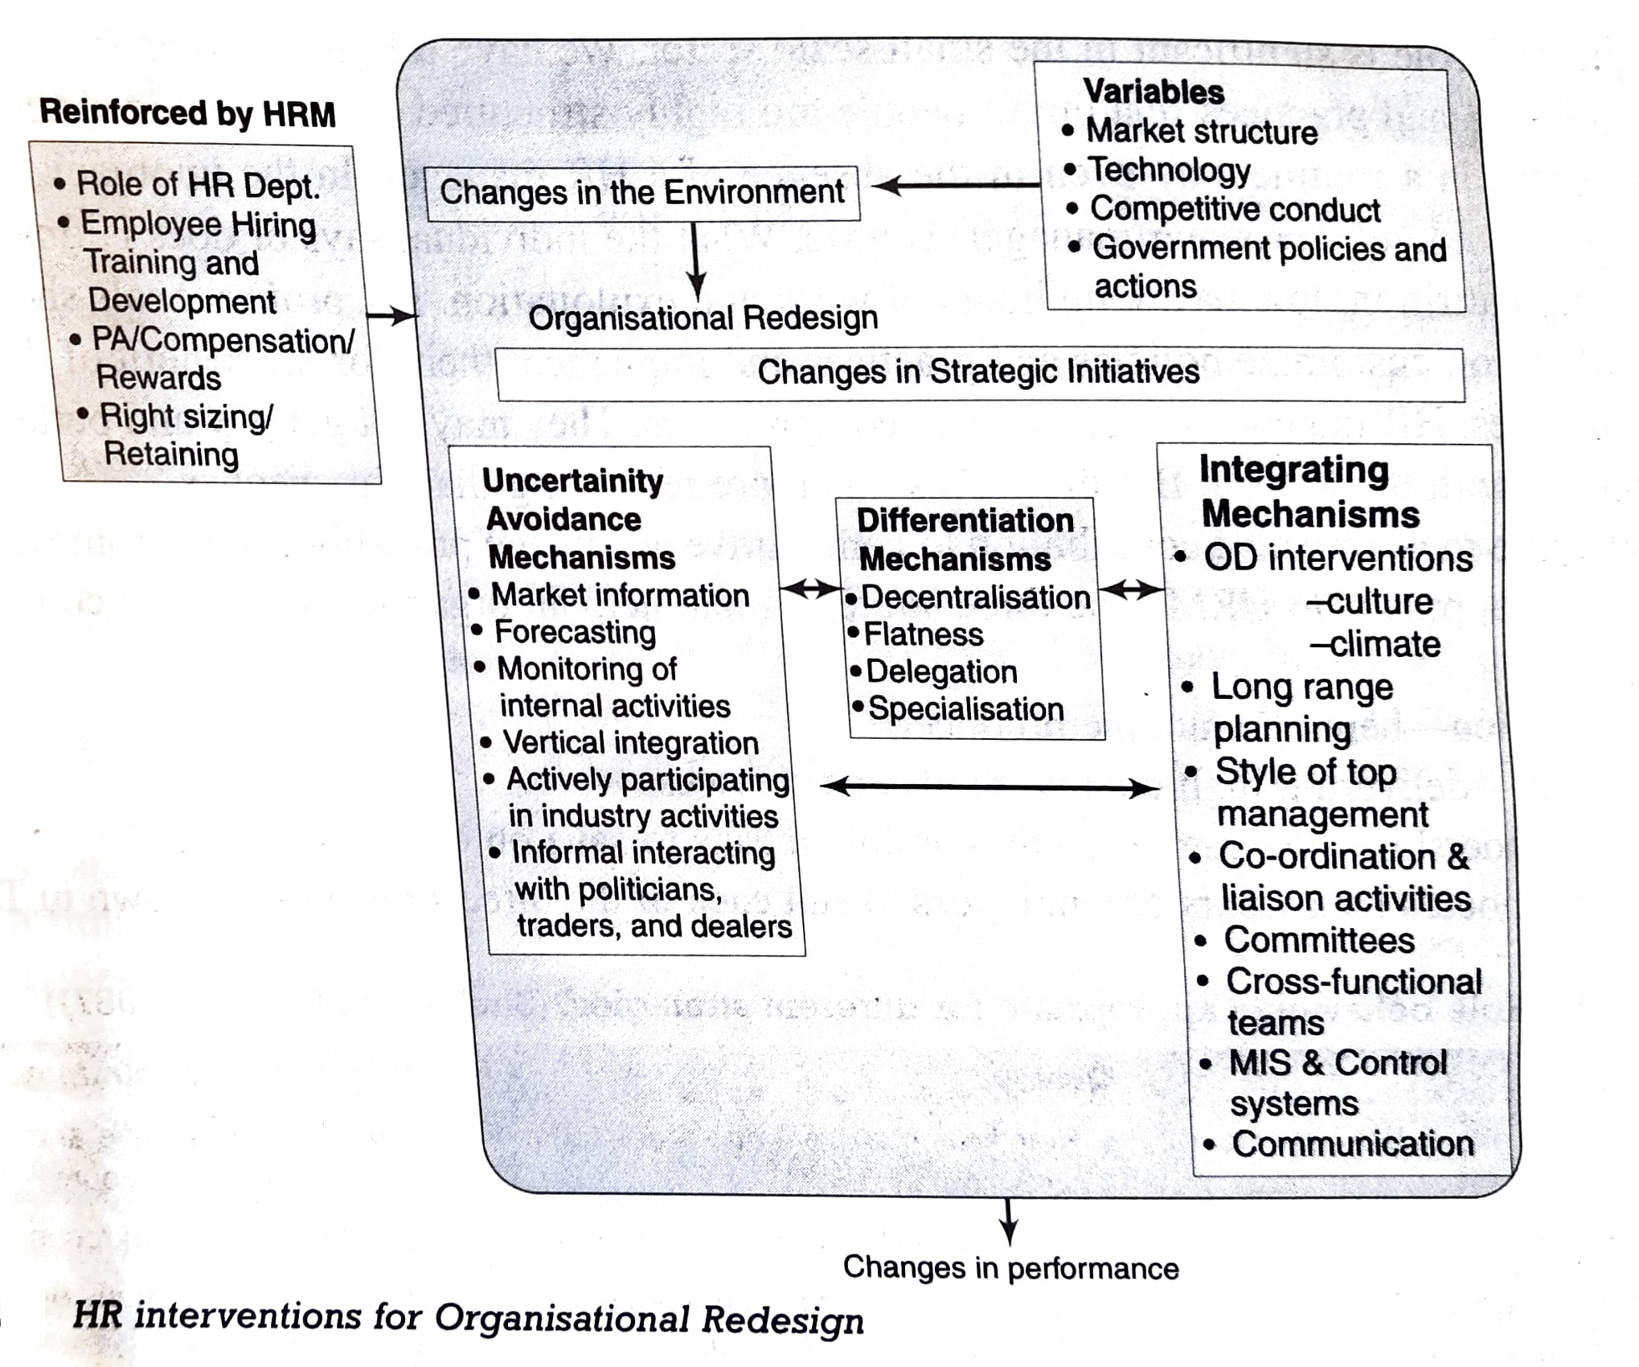

Slide 11
HRM Functions
Planning
Staffing
Developing
Monitoring
Maintaining
Managing relationships
Managing change
Evaluating

Slide 12
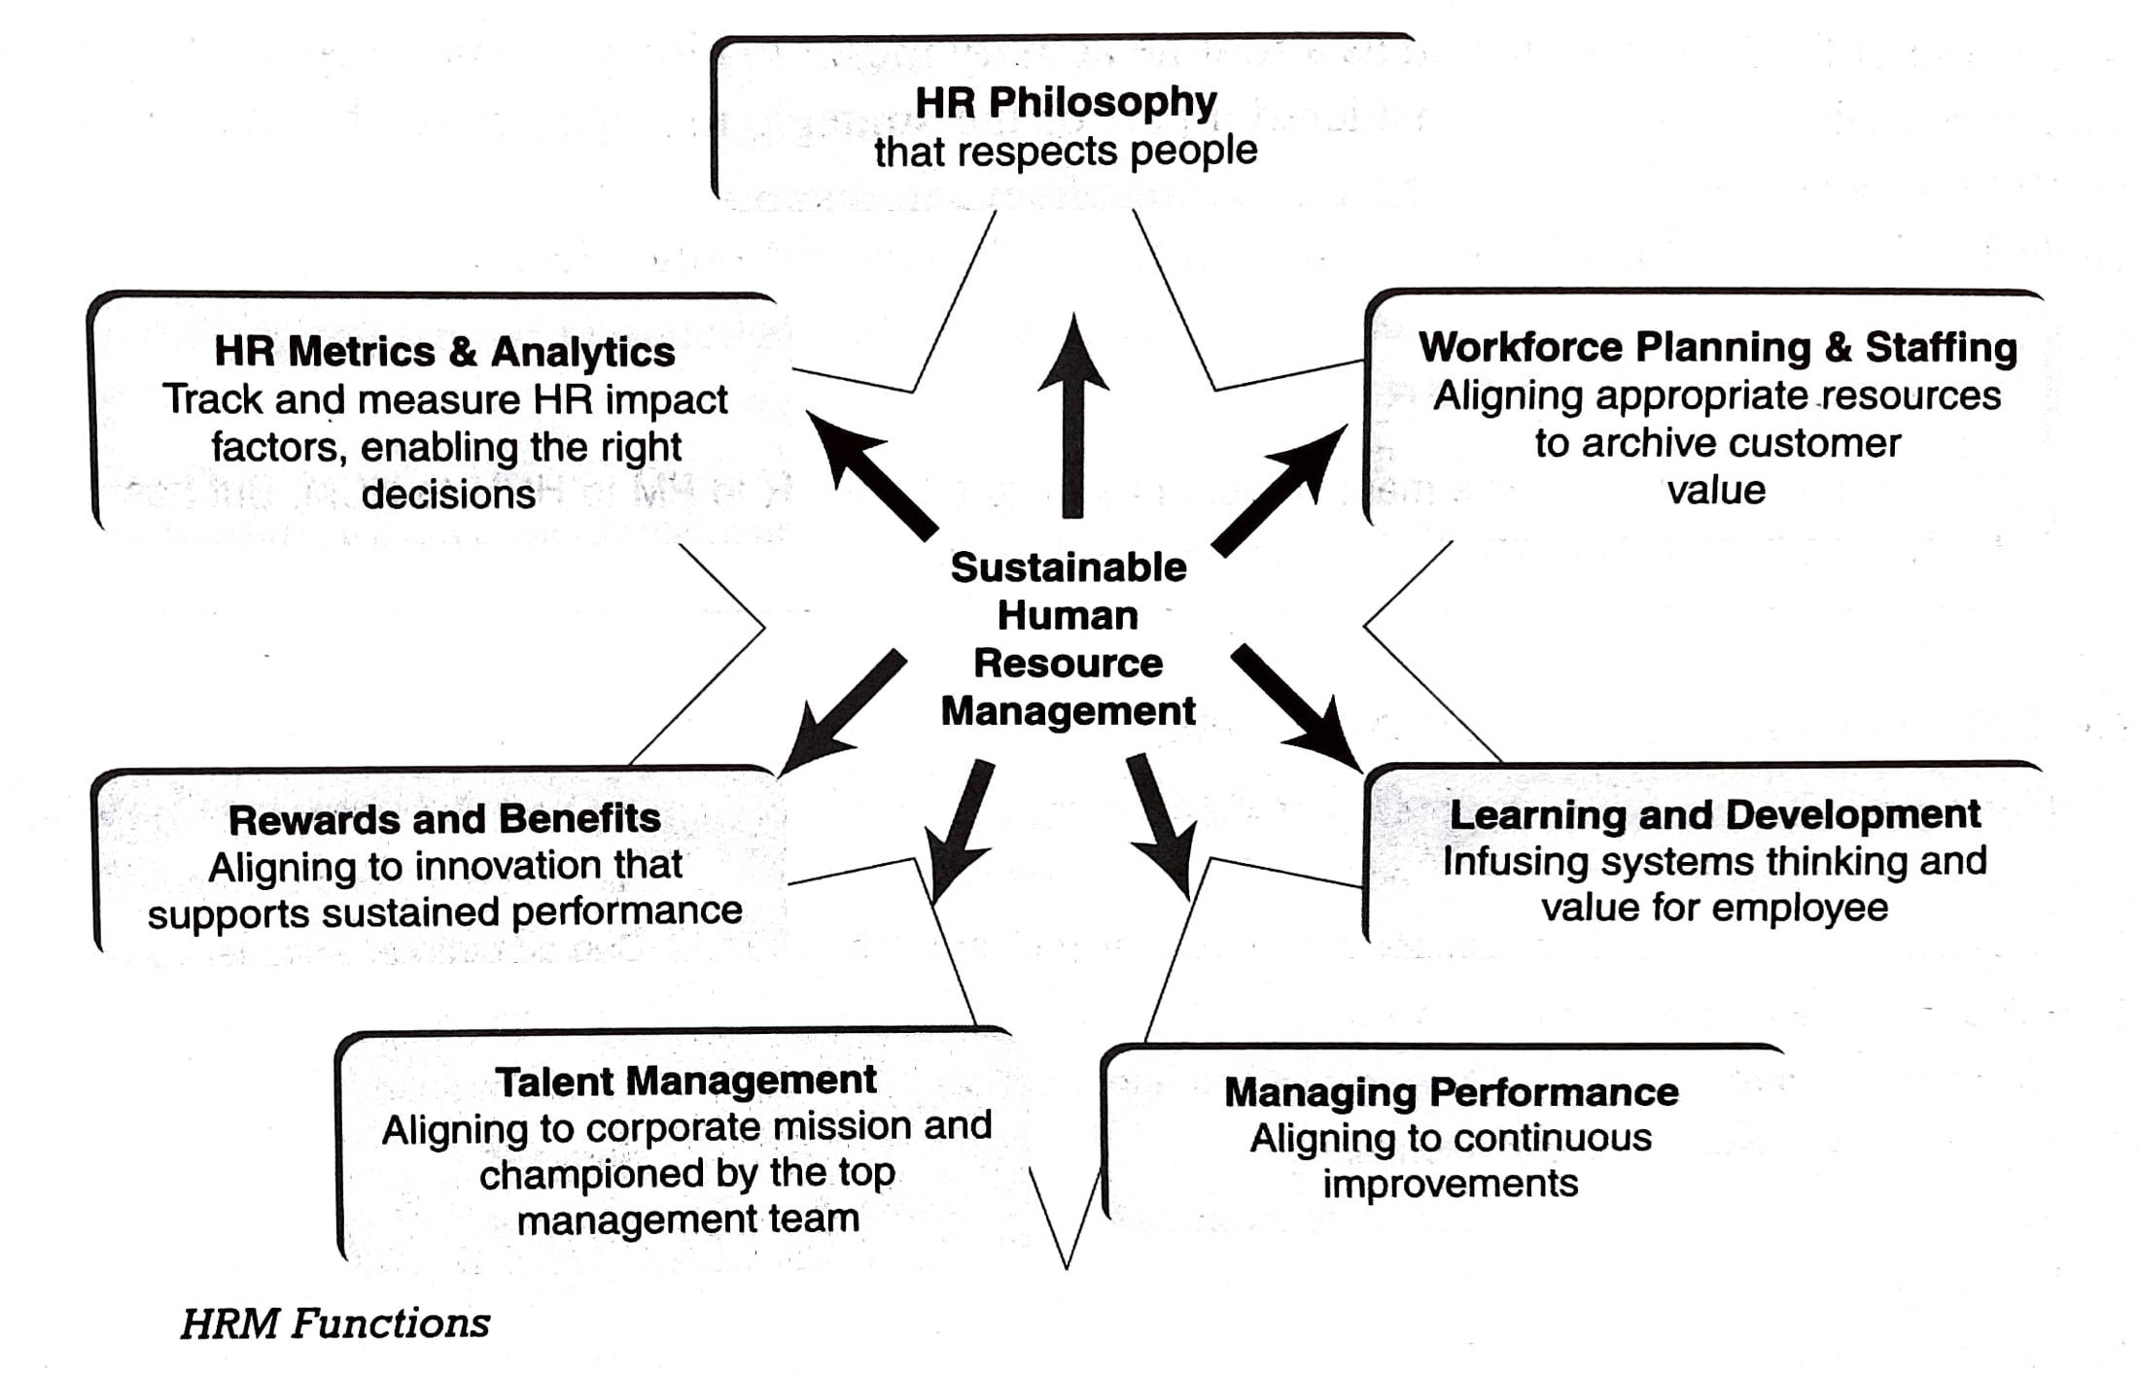

Slide 13
New Age HR functions:
Visioneering and strategizing to gain competitive edge for the organizations
Aligning HR activities with corporate objectives and focus on achieving strategic outcomes
Focusing on competency development
Redefining role of HR mangers and renegotiating their roles and relationships with line managers within the organizations

Slide 14
Develop methods for producing alignment between employee goals and behaviors and organizational strategy
Define, communicate, and leverage organizations’ key capabilities
Create, distribute and support HR new philosophies that support both employees and the organization

Slide 15
Objectives of HRM
Ensure the availability of a competent and willing workforce to an organization.
Four fold objectives:
Societal
Organizational
Functional
Personal

Slide 16
Objectives of HRM

Slide 17
Societal Objectives:
To be ethically and socially responsible to the needs and challenges of the society while minimizing the negative impact of such demands upon the organization
Organizational Objectives:
To recognize the role of HRM in bringing about organizational effectiveness
Functional Objectives:
To maintain the department’s contribution at a level appropriate to the organization’s needs

Slide 18
Personal Objectives:
To assist employees in achieving their personal goals, at least insofar as these goals enhance the individual’s contribution to the organization
Specific Objectives:
Facilitate organizational goals setting.
Making competent and motivated employees available for the organization all the time
Align HR policies and practices with the organization’s strategies
Play the role of a change agent in order to introduce change in the organization

Slide 19
Specific Objectives: (contd..)
Build an ethical and culture-embedded organization
Make employees feel that their stay in the organization is desirable, rewarding and fulfilling
Make the organization a leader in its area of operation, bets employer to work for and a preferred choice for job aspirants
Make the organization contribute to sustainable development

Slide 20
Personnel Policies
A policy is a plan of action – a statement of intention committing the management to a general course of action
Organizations need to evolve HR policies as they ensure consistency and uniformity in treating people
Motivate and build loyalty
Policies become benchmarks to compare and evaluate performance
A policy statement is more specific and commits the management to a definite course of action
Does not spell out the detailed procedure

Slide 21
Benefits of having HR Policies
Makes management to give a deep thought to the basic needs of both the organization and the employees
Consistent treatment of all personnel throughout the organization
Continuity of action is assured even though top-management personnel change
Serve as standard of performance
Help build employee motivation and loyalty
Help resolve intrapersonal, interpersonal and intergroup conflicts
Policies reflect the maturity and wisdom of the organization

Slide 22
Examples:
Hiring policies
Terms and conditions of employment
Medical assistance
Housing, transport, uniform and allowances
Training and development
Industrial relations

Slide 23
Formulating Policies
Five principal sources for determining the content and meaning of policies:
Past practice in the organization
Prevailing practice in rival companies
Attitudes and philosophy of founders of the company, directors and top management
Attitudes and philosophy of middle and lower management
The knowledge and experience gained from handling countless personnel problems on a day-to-day basis

Slide 24
Policies must be stable
Should not be rigid
Policy must enunciate a principle and not care for minute details
Reflect the goals and values of the organization
Not and isolated document: an integral part of the overall corporate philosophy of the company

Slide 25
Evolution of HRM in India
HRM Term emerged during the 1970s
Traditional titles: Personnel Management or Personnel Administration
Kautilya’s Arthashastra: There existed a sound base for systematic management of resources as early as the 4th century B.C.
Early 1800BC: ‘minimum wage rate’ and ‘ incentive wage plan’ were included in the Babylonian Code of Hammurabi

Slide 26
Since 1920s: Chronicle of the growth of the subject started in India.
Reasons: First World War, emergence of trade unions
1931: The Royal commission recommended the appointment of labour-welfare officers to deal with the selection if workers and to settle their grievances
1948: The Factories Act made appointment of welfare officers compulsory in industrial establishments employing 500 or more workers each.

Slide 27
Professional bodies namely, Indian institute of Personnel Management (IIPM), HQ Kolkata and National Institute of Labour Management (NILM), HQ Mumbai were set up
1960s: Post WWII, the scope of personnel function expanded leading to the emergence of profession called Personnel Management (PM)
1970s: Shift from a concern for welfare to a focus on efficiency

Slide 28
1980s: Thinking about new technologies, HRM challenges and HRD
IIPM and NILM merged to form the National Institute of Personnel Management (NIPM)
Technological advances reduced administrative work of HR professionals and allowed them to focus on strategic issues.
1990s: Shift in emphasis to human values and productivity through people

Slide 29
American Society of Personnel Administration (ASPA) was renamed as the Society for Human Resources Management (SHRM)
Thus, since 1920s, the subject of people management has grown into a matured profession

Slide 31
Human Resource Planning (HRP)

Slide 32
Importance / Uses / Benefits of HRP
HRP is the process of forecasting a firm’s future demand for, and supply of, the right type of people in the right number
It is a sub-system in the total organizational planning
Organizational planning includes managerial activates that set the company’s objectives for the future and determines the appropriate means for achieving those objectives
The term ‘manpower planning’ was prevalent during the mid-twentieth century
As the scope widened the contemporary term HRP evolved and is more acceptable as it is gender-neutral

Slide 33
Importance of HRP
Taking care of HR needs
Part of strategic planning
Creating highly talented personnel
International strategies
Foundation of personnel functions
HRP helps in identifying talent, making a list of vacant global assignments and preparing action plans for rotation
Unite the perspectives of line and staff managers

Slide 34
Other benefits
Provide a better view of the HR dimensions of business decisions
Personnel costs may be less because the management can anticipate imbalances before they become unmanageable and expensive
More time is provided to locate talent
Better opportunities to develop women and minority groups in future growth plan
Better planning of assignments to develop managers
Major and successful demands on local labour markets can be made.

Slide 35
Factors affecting HRP
Type and strategy of organization
Organizational growth cycles and planning
Environmental uncertainties
Time horizons
Type and quality of forecasting information
Nature of jobs being filled
Off-loading the work (outsourcing)

Slide 36
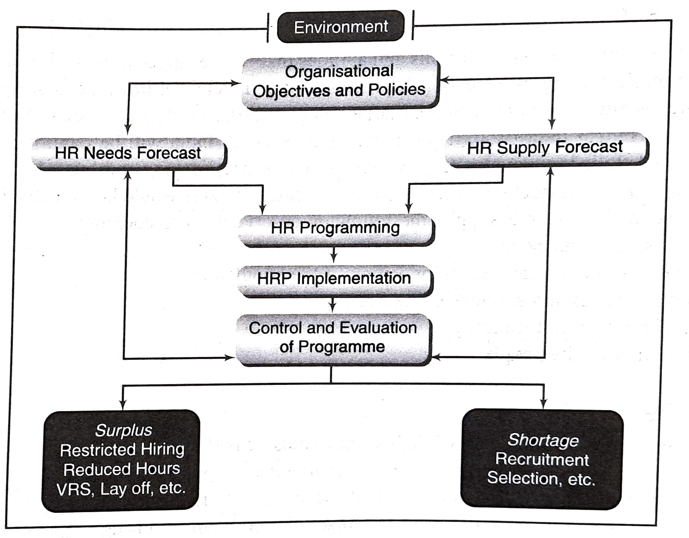
The HRP Process

Slide 37
Planning Process
Forecasting personnel needs, assessing personnel supply and matching demand-supply factors through personnel-related programmes
Influenced by overall organizational objectives and the environment of business
Environmental Scanning
Economic factors, including regional general and regional conditions
Technological changes
Demographic changes
Political and legislative issues
Social concerns

Slide 38
Organizational Objectives and Policies
HR Demand Forecast
Effective demand forecasting is the process of estimating the future quantity and quality of people required, and the best way to meet this demand
Basis: annual budget and long-term corporate plan
Must consider external as well as internal factors
External factors: competition, economic climate, laws and regulatory bodies, changes in technology, and social factors
Internal factors: budget constrains, production levels, new products and services, organizational structure, and employee separations

Slide 39
Advantages of HR demand forecast:
Quantify the jobs necessary for producing a given number of goods, or offering a given level of services
Determine what staff-mix is desirable in the future
Assess appropriate staffing levels in different parts of the organization so as to avoid unnecessary costs
Prevent shortages of people where and when they are needed most
Monitor compliance with legal requirements

Slide 40
Forecasting Techniques:
Vary from simple to sophisticated
Managerial judgement
Ratio-trend analysis
Regression analysis
Work study techniques
Delphi technique
Flow models (Ex. Markov model)

